Slide 1
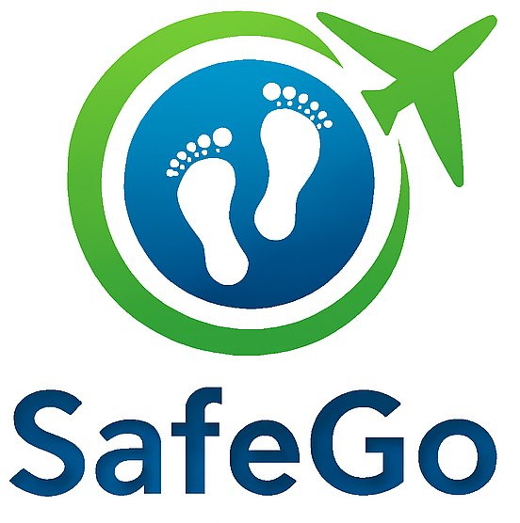


SMART INDIA HACKATHON 2025
Problem Statement ID –SIH25002
Problem Statement Title - Smart Tourist Safety Monitoring & Incident Response System using Al, Geo-Fencing, and Blockchain-based Digital ID
Theme- Travel & Tourism
PS Category- Software
Team ID-
Team Name: Coffee & Code

Slide 2
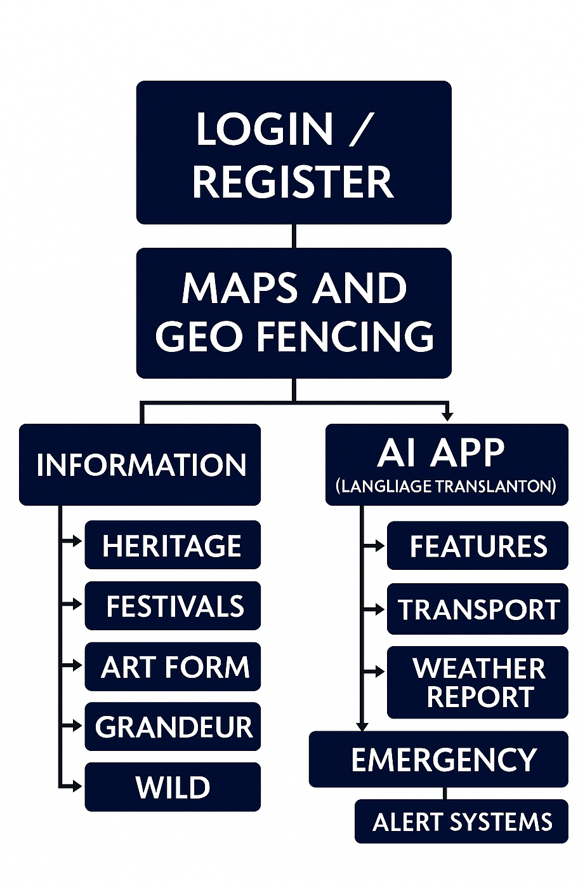
SafeGo
Coffee & Code
Proposed Solution
Smart Mobile Application ensuring tourist safety and seamless travel experience.
AI-powered alerts & Geo-fencing to notify users of risks in selected areas.
Blockchain-based Digital ID for secure tourist authentication and incident response.
Chatbot Assistance with real-time language translation and periodic well-being checks.
Integrated Transport Guidance with translation support for hassle-free travel.
Cultural & Heritage Insights – access to festivals, heritage sites, and local attractions.
24/7 Tourist Support System for safety, communication, and convenience.

Slide 3

TECHNICAL APPROACH
Coffee & Code
Technologies Used:
Frontend / Mobile App: Java (cross-platform Android/iOS UI)
Backend & Database: Firebase (Authentication, Firestore for real-time data)
AI / ML: TensorFlow Lite / Dialogflow (chatbot, language translation, incident detection)
Geo-Fencing & Maps: Google Maps API
Blockchain: Ethereum / Hyperledger (digital ID & secure transactions)
Implementation Workflow:
User Login – Secure authentication via Blockchain Digital ID
Destination Selection & Geo-Fencing – AI monitors location & sends alerts
Information Access – Heritage, festivals, art, local attractions
AI Chatbot – Language translation, wellness checks, local time
Transportation & Weather – Routes, local transport, weather info
Emergency Alerts – Quick incident reporting

Slide 4
FEASIBILITY AND VIABILITY
Coffee & Code
Feasibility Analysis
Technical Feasibility: All technologies (AI, Geo-Fencing, Blockchain, Mobile App) are mature and integrable.
Operational Feasibility: Users can easily access the app via smartphones; cloud-based backend ensures scalability.
Economic Feasibility: Cost-effective using open-source tools (Flutter, Firebase, Google Maps API) and cloud services.
Social Feasibility: Promotes tourist safety, cultural awareness, and convenience, increasing adoption potential.
Potential Challenges & Risks
Connectivity Issues: Real-time alerts and map tracking require stable internet/GPS.
Data Privacy & Security: Storing location and personal info requires strong security measures.
User Adoption: Tourists may be hesitant to use a new app in unfamiliar regions.
Accuracy of AI Alerts: False positives or missed incidents could reduce trust.
Integration Complexity: Coordinating maps, AI, blockchain, and transport info seamlessly.
Strategies to Overcome Challenges
Offline Mode & Caching: Allow partial app functionality even without internet.
Blockchain & Encryption: Ensure secure digital ID and encrypted user data.
User-Friendly Design: Simple UI/UX and multilingual support to encourage adoption.
AI Model Training & Testing: Continuous improvement using historical data for accurate alerts..

Slide 5
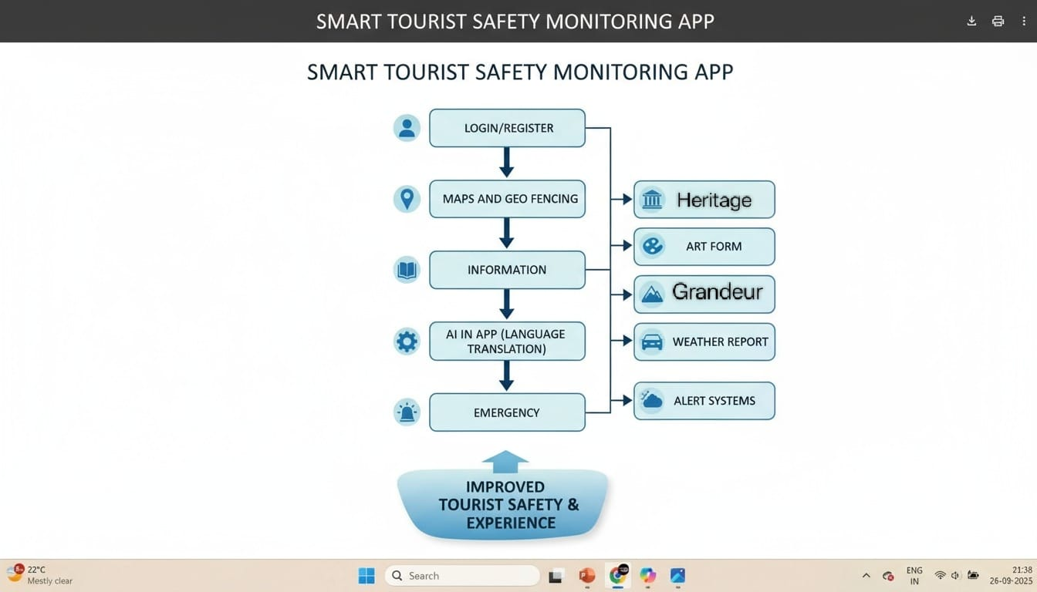
IMPACT AND BENEFITS
Coffee & Code
Potential Impact on Target Audience
Enhanced Safety: Real-time alerts reduce risks for tourists in unfamiliar areas.
Improved Experience: Easy access to heritage, festivals, and transport info enhances travel convenience.
Cultural Awareness: Promotes knowledge of local traditions, sites, and events.
Empowerment: Language translation and AI assistance make travel stress-free.
Benefits of the Solution
Social: Safer tourism, better communication, increased cultural engagement.
Economic: Encourages tourism growth, supporting local businesses and services.
Technological: Demonstrates integration of AI, Geo-Fencing, and Blockchain in real-world applications.
Environmental: Reduces unnecessary travel or exposure to risky areas through smart routing and alerts.

Slide 6
RESEARCH AND REFERENCES
Coffee & Code
Smart Health Monitoring System for Tourists in Remote Destinations
Summary: This paper presents a system that integrates geo-fencing, real-time alerts, and cloud storage to ensure tourists' safety and enhance emergency response times. It utilizes GPS, LoRaWAN-based communication modules, and cloud computing to provide precise location tracking and instant emergency alerts .
Smart Tourist Safety with AI, Geo-Fencing & Blockchain ID
Summary: This project leverages AI for incident detection, geo-fencing for real-time alerts, and blockchain for secure digital IDs to enhance tourist safety. It integrates these technologies to provide quick help and seamless protection for travelers .

